Slide 1

MODULE V GAME PLAYING

Slide 2
Types of algorithms in Adversarial search
Adversarial search is a game-playing technique where the agents are surrounded by a competitive environment.
It is also obvious that the solution for the goal state will be an optimal solution because the player will try to win the game with the shortest path and under limited time.
There are following types of adversarial search:
Min-max Algorithm
Alpha-beta Pruning.

Slide 3
Mini-Max Algorithm
In artificial intelligence, minimax is a decision-making strategy under game theory, which is used to minimize the losing chances in a game and to maximize the winning chances.
This strategy is also known as ‘Min-max,’ ’MM,’ or ‘Saddle point.’

Slide 4
Mini-Max Algorithm
Mini-max algorithm is a recursive or backtracking algorithm which is used in decision-making and game theory. It provides an optimal move for the player assuming that opponent is also playing optimally.
Mini-Max algorithm uses recursion to search through the game-tree.
Example : Chess, Checkers, tic-tac-toe
In this algorithm two players play the game; one is called MAX and other is called MIN.

Slide 5
Mini-Max Algorithm
Both the players fight it as the opponent player gets the minimum benefit while they get the maximum benefit.
MIN: Decrease the chances of MAX to win the game.
MAX: Increases his chances of winning the game.
The minimax algorithm performs a depth-first search algorithm for the exploration of the complete game tree.
The minimax algorithm proceeds all the way down to the terminal node of the tree, then backtrack the tree as the recursion.

Slide 6
Working of Min-Max Algorithm
MINIMAX algorithm is a backtracking algorithm where it backtracks to pick the best move out of several choices.
MINIMAX strategy follows the DFS (Depth-first search) concept.
Here, we have two players MIN and MAX, and the game is played alternatively between them, i.e., when MAX made a move, then the next turn is of MIN.
It means the move made by MAX is fixed and, he cannot change it.
The same concept is followed in DFS strategy, i.e., we follow the same path and cannot change in the middle.
That’s why in MINIMAX algorithm, instead of BFS, we follow DFS.

Slide 7
Working of Min-Max Algorithm
Keep on generating the game tree/ search tree till a limit d.
Compute the move using a heuristic function.
Propagate the values from the leaf node till the current position following the minimax strategy.
Make the best move from the choices.

Slide 8
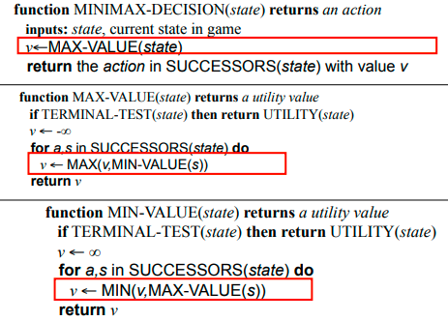
Pseudocode for Minimax Algorithm

Slide 9
Step 1
In the first step, the algorithm generates the entire game-tree and apply the utility function to get the utility values for the terminal states.
In the below tree diagram, let's take A is the initial state of the tree.
Suppose maximizer takes first turn which has worst-case initial value =- infinity, and minimizer will take next turn which has worst-case initial value = +infinity.

Slide 10
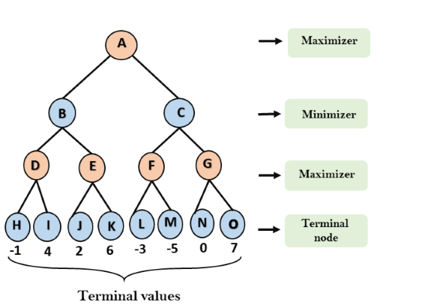

Slide 11
Step 2
Now, first we find the utilities value for the Maximizer, its initial value is -∞, so we will compare each value in terminal state with initial value of Maximizer and determines the higher nodes values. It will find the maximum among the all.
For node D max(-1,- -∞) => max(-1,4)= 4
For Node E max(2, -∞) => max(2, 6)= 6
For Node F max(-3, -∞) => max(-3,-5) = -3
For node G max(0, -∞) = max(0, 7) = 7

Slide 12
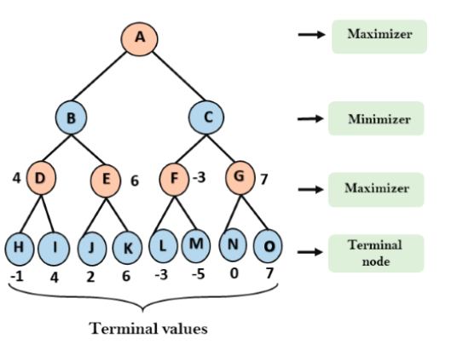

Slide 13
Step 3
In the next step, it's a turn for minimizer, so it will compare all nodes value with +∞ and will find the 3rd layer node values.
For node B= min(4,6) = 4
For node C= min (-3, 7) = -3

Slide 14
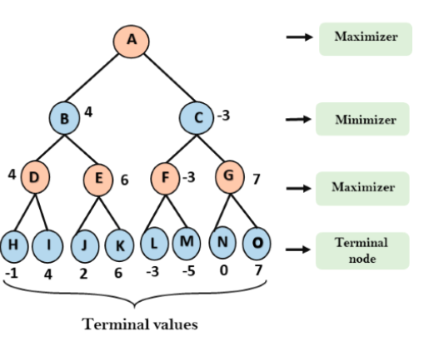

Slide 15
Step 4
Now it's a turn for Maximizer, and it will again choose the maximum of all nodes value and find the maximum value for the root node.
In this game tree, there are only 4 layers, hence we reach immediately to the root node, but in real games, there will be more than 4 layers.
For node A max(4, -3)= 4

Slide 16
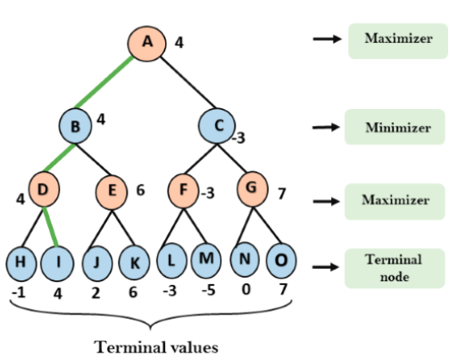

Slide 17
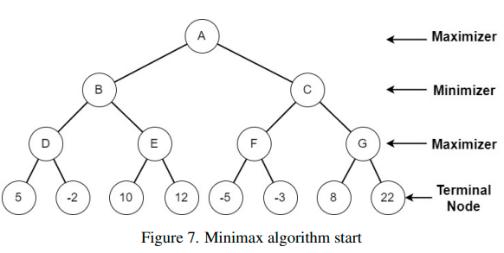
Example 2

Slide 18
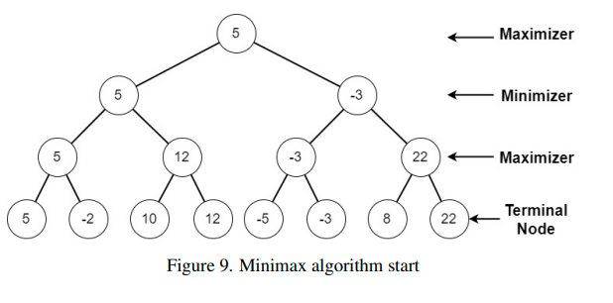
Solution

Slide 19
Limitation of the minimax Algorithm
The main drawback of the minimax algorithm is that it gets really slow for complex games such as Chess, go, etc.
This type of games has a huge branching factor, and the player has lots of choices to decide.
This limitation of the minimax algorithm can be improved from alpha-beta pruning.

Slide 20
Alpha-Beta Pruning Exploiting the Fact of an Adversary
If a position is probably bad:
It is NO USE expending search time to find out exactly how bad
If the adversary can force a bad position:
It is NO USE expending search time to find out the good positions that the adversary won’t let you achieve anyway
Bad = not better than we already know we can achieve elsewhere.
Contrast normal search:
ANY node might be a winner.
ALL nodes must be considered.
(A* avoids this through knowledge, i.e., heuristics)

Slide 21
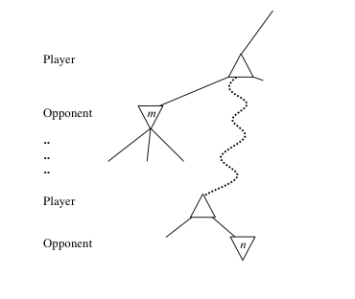
General alpha-beta pruning
Consider a node n in the tree ---
If player has a better choice at:
Parent node of n
Or any choice point further up
Then n will never be reached in play.
Hence, when that much is known about n, it can be pruned.

Slide 22
Alpha-beta Algorithm
Depth first search
only considers nodes along a single path from root at any time
α = highest-value choice found at any choice point of path for MAX
(initially, α = −infinity)
β = lowest-value choice found at any choice point of path for MIN
(initially, β = +infinity)
Pass current values of α and β down to child nodes during search.
Update values of α and β during search:
MAX updates α at MAX nodes
MIN updates β at MIN nodes
Prune remaining branches at a node when α ≥ β

Slide 23
When to Prune
Prune whenever α ≥ β.
Prune below a Max node whose alpha value becomes greater than or equal to the beta value of its ancestors.
Max nodes update alpha based on children’s returned values.
Prune below a Min node whose beta value becomes less than or equal to the alpha value of its ancestors.
Min nodes update beta based on children’s returned values.

Slide 24
Pseudocode for Alpha-Beta Algorithm
function ALPHA-BETA-SEARCH(state) returns an action
inputs: state, current state in game
v←MAX-VALUE(state, - ∞ , +∞)
return the action in ACTIONS(state) with value v
function MAX-VALUE(state,α , β) returns a utility value
if TERMINAL-TEST(state) then return UTILITY(state)
v ← - ∞
for a in ACTIONS(state) do
v ← MAX(v,MIN-VALUE(Result(s,a), α , β))
if v ≥ β then return v
α ← MAX(α ,v)
return v
(MIN-VALUE is defined analogously)

Slide 25
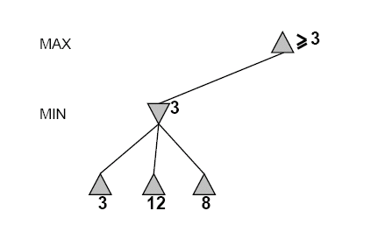
Alpha-Beta Example Revisited
Do DF-search until first leaf
α, β, initial values
α=−∞
β =+∞
α, β, passed to kids
α=−∞
β =+∞

Slide 26
Alpha-Beta Example (continued)
α=−∞
β =+∞
α=−∞
β =3
MIN updates β, based on kids

Slide 27
Alpha-Beta Example (continued)
α=−∞
β =+∞
α=−∞
β =3
MIN updates β, based on kids.
No change.

Slide 28
Alpha-Beta Example (continued)
MAX updates α, based on kids.
α=3
β =+∞
3 is returned
as node value.

Slide 29
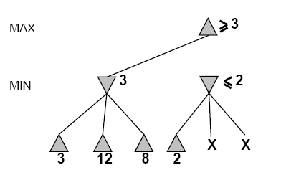
Alpha-Beta Example (continued)
α=3
β =+∞
α, β, passed to kids
α=3
β =+∞

Slide 30
Alpha-Beta Example (continued)
α=3
β =+∞
MIN updates β,
based on kids.
α=3
β =2

Slide 31
Alpha-Beta Example (continued)
α=3
β =+∞
α=3
β =2
α ≥ β,
so prune.

Slide 32
Alpha-Beta Example (continued)
MAX updates α, based on kids.
No change.
α=3
β =+∞
2 is returned
as node value.

Slide 33
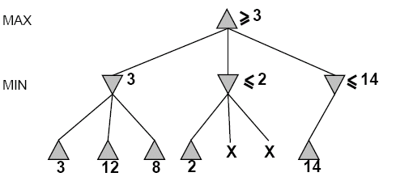
Alpha-Beta Example (continued)
α=3
β =+∞
,
α, β, passed to kids
α=3
β =+∞

Slide 34
Alpha-Beta Example (continued)
α=3
β =+∞
,
MIN updates β,
based on kids.
α=3
β =14

Slide 35
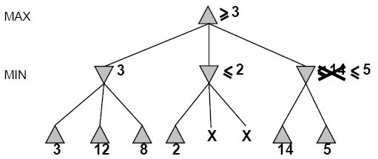

Alpha-Beta Example (continued)
α=3
β =+∞
,
MIN updates β,
based on kids.
α=3
β =5

Slide 36
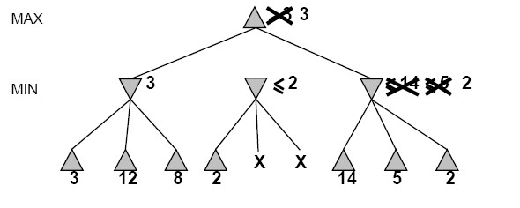
Alpha-Beta Example (continued)
α=3
β =+∞
2 is returned
as node value.
2

Slide 37
Alpha-Beta Example (continued)
Max calculates the same node value, and makes the same move!
2

Slide 38
Effectiveness of Alpha-Beta Search
Worst-Case
branches are ordered so that no pruning takes place. In this case alpha-beta gives no improvement over exhaustive search
Best-Case
each player’s best move is the left-most child (i.e., evaluated first)
in practice, performance is closer to best rather than worst-case
E.g., sort moves by the remembered move values found last time.
E.g., expand captures first, then threats, then forward moves, etc.
E.g., run Iterative Deepening search, sort by value last iteration.
In practice often get O(b^{(d/2)}) rather than O(b^{d})
this is the same as having a branching factor of sqrt(b),
(sqrt(b))^{d} = b^{(d/2)},i.e., we effectively go from b to square root of b
e.g., in chess go from b ~ 35 to b ~ 6
this permits much deeper search in the same amount of time

Slide 39
Final Comments about Alpha-Beta Pruning
Pruning does not affect final results
Entire subtrees can be pruned.
Good move ordering improves effectiveness of pruning
Repeated states are again possible.
Store them in memory = transposition table

Slide 40
Example 1
-which nodes can be pruned?
3
4
6
5
8
7
2
1

Slide 41
Answer to Example 1
-which nodes can be pruned?
Max
Min
Max
3
4
6
5
8
7
2
1

Slide 42
Example 2
-which nodes can be pruned?
5
6
3
4
1
2
7
8

Slide 43
Answer to Example 2
-which nodes can be pruned?
Max
Min
Max
5
6
3
4
1
2
7
8
Answer: NONE! Because the most favorable nodes for both are explored last (i.e., in the diagram, are on the right-hand side).

